Slide 1
Marching Squares
Ed Angel
Professor of Computer Science, Electrical and Computer Engineering, and Media Arts
University of New Mexico
Angel: Interactive Computer Graphics 5E © Addison-Wesley 2009

Slide 2
Objectives
Nontrivial two-dimensional application
Important method for
  Contour plots
  Implicit function visualization
Extends to important method for volume visualization
This lecture is optional
Material not needed to continue to Chapter 3
Angel: Interactive Computer Graphics 5E © Addison-Wesley 2009

Slide 3
Displaying Implicit Functions
Consider the implicit function
g(x,y)=0
Given an x, we cannot in general find a corresponding y
Given an x and a y, we can test if they are on the curve
Angel: Interactive Computer Graphics 5E © Addison-Wesley 2009

Slide 4
Height Fields and Contours
In many applications, we have the heights given by a function of the form z=f(x,y)
To find all the points that have a given height c, we have to solve the implicit equation g(x,y)=f(x,y)-c=0
Such a function determines the isosurfaces or contours of f for the isosurface value c
Angel: Interactive Computer Graphics 5E © Addison-Wesley 2009

Slide 5
Marching Squares
Displays isocurves or contours for functions f(x,y) = t
Sample f(x,y) on a regular grid yielding samples {f_{ij}(x,y)}
These samples can be greater than, less than, or equal to t
Consider four samples f_{ij}(x,y), f_{i+1,j}(x,y), f_{i+1,j+1}(x,y), f_{i,j+1}(x,y)
These samples correspond to the corners of a cell
Color the corners by whether than exceed or are less than the contour value t
Angel: Interactive Computer Graphics 5E © Addison-Wesley 2009

Slide 6
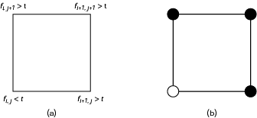
Cells and Coloring
Angel: Interactive Computer Graphics 5E © Addison-Wesley 2009

Slide 7
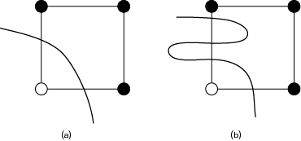
Occum’s Razor
Contour must intersect edge between a black and white vertex an odd number of times
Pick simplest interpretation: one crossing
Angel: Interactive Computer Graphics 5E © Addison-Wesley 2009

Slide 8
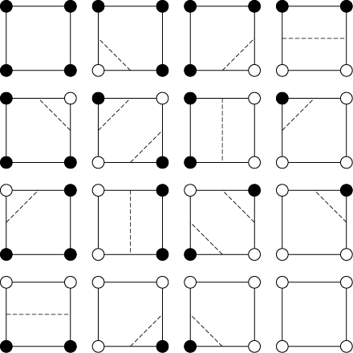
16 Cases
Angel: Interactive Computer Graphics 5E © Addison-Wesley 2009

Slide 9

Unique Cases
Taking out rotational and color swapping symmetries leaves four unique cases
First three have a simple interpretation
Angel: Interactive Computer Graphics 5E © Addison-Wesley 2009

Slide 10

Ambiguity Problem
Diagonally opposite cases have two equally simple possible interpretations
Angel: Interactive Computer Graphics 5E © Addison-Wesley 2009

Slide 11
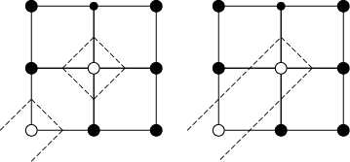
Ambiguity Example
Two different possibilities below
More possibilities on next slide
Angel: Interactive Computer Graphics 5E © Addison-Wesley 2009

Slide 12
Ambiguity Problem
Angel: Interactive Computer Graphics 5E © Addison-Wesley 2009

Slide 13
Is Problem Resolvable?
Problem is a sampling problem
  Not enough samples to know the local detail
  No solution in a mathematical sense without extra information
More of a problem with volume extension (marching cubes) where selecting “wrong” interpretation can leave a hole in a surface
Multiple methods in literature to give better appearance
  Supersampling
  Look at larger area before deciding
Angel: Interactive Computer Graphics 5E © Addison-Wesley 2009

Slide 14
Interpolating Edges
We can compute where contour intersects edge in multiple ways
  Halfway between vertics
  Interpolated based on difference between contour value and value at vertices
Angel: Interactive Computer Graphics 5E © Addison-Wesley 2009

Slide 15


Example: Oval of Cassini
f(x,y)=(x²+y²+a²)²-4a²x²-b⁴
Depending on a and b we can have 0, 1, or 2 curves
midpoint intersections
interpolating intersections
Angel: Interactive Computer Graphics 5E © Addison-Wesley 2009

Slide 16
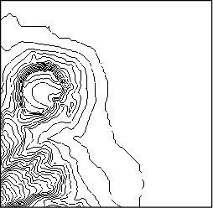
Contour Map
Diamond Head, Oahu Hawaii
Shows contours for many contour values
Angel: Interactive Computer Graphics 5E © Addison-Wesley 2009

Slide 17
Marching Cubes
Isosurface: solution of g(x,y,z)=c
Same argument to derive method but use cubic cell (8 vertices, 256 colorings)
Standard method of volume visualization
Suggested by Lorensen and Kline before marching squares
Angel: Interactive Computer Graphics 5E © Addison-Wesley 2009

